Slide 1


Deep Learning (DL)
Lab5
Natural Language Processing (NLP)
Word Embedding

Slide 2
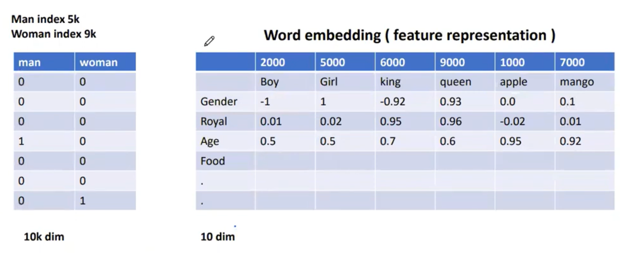
One Hot Encoder
high-dimensional vectors
Sparse Matrix
Does not capture semantic relationships between words

Slide 3
Word Embedding

Slide 4
Word Embedding
Word embeddings give us a way to use an efficient, dense representation in which similar words have a similar encoding.
you do not have to specify this encoding by hand.
An embedding is a dense vector of floating-point values

Slide 5
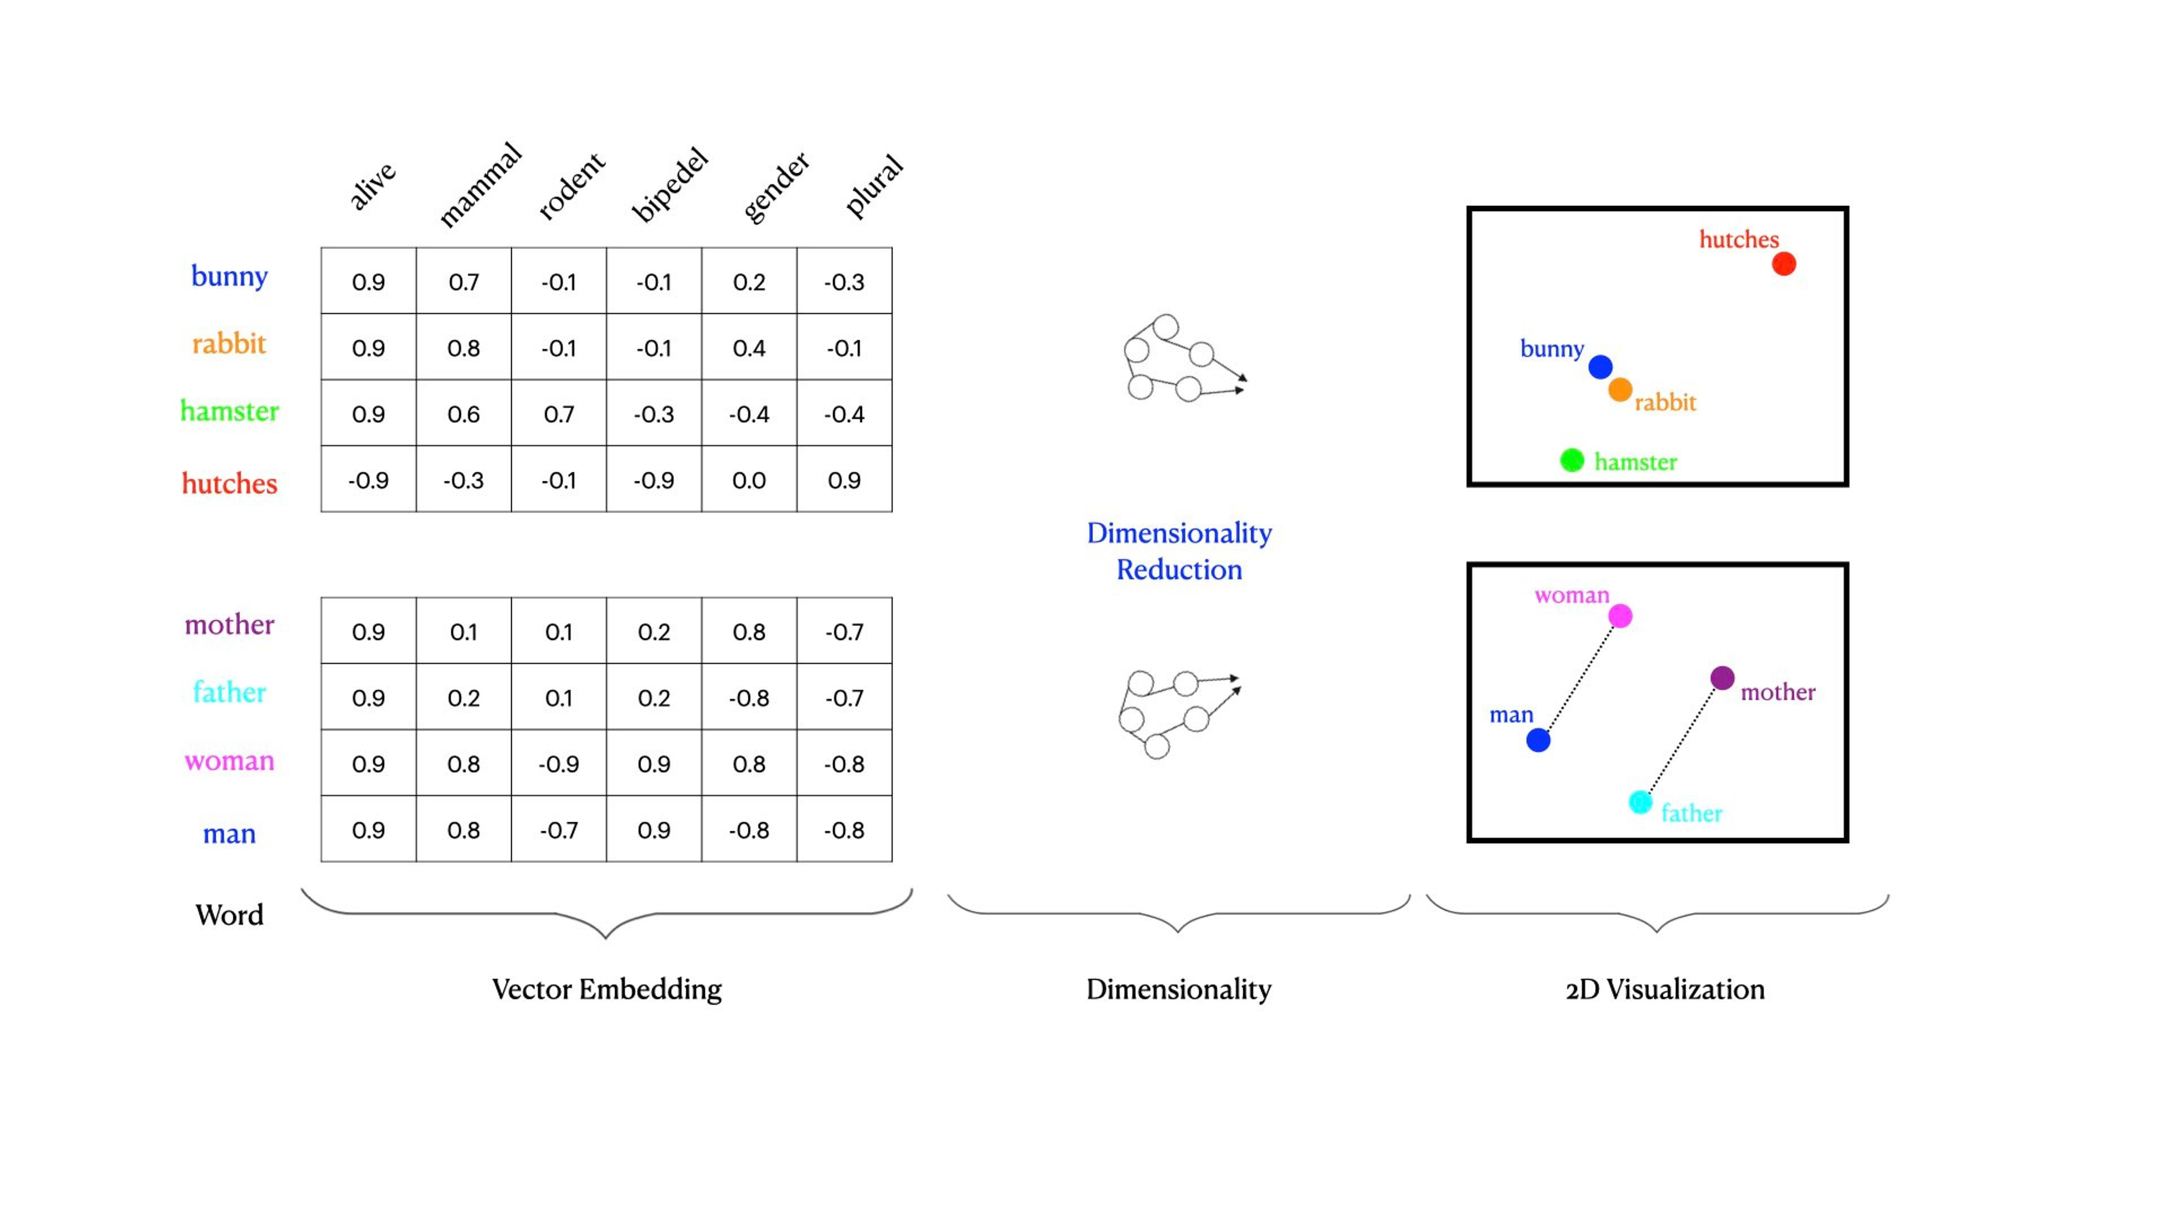

Slide 6
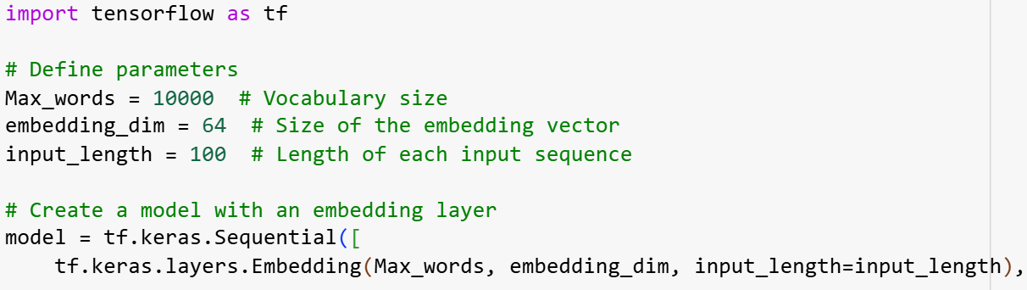
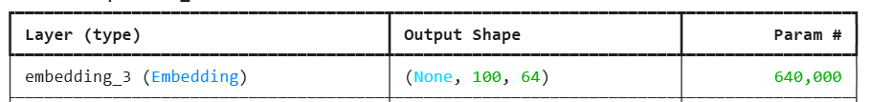


Slide 7
Deep Learning (DL)
Lab5
Natural Language Processing (NLP)
Tokenization & Padding

Slide 8
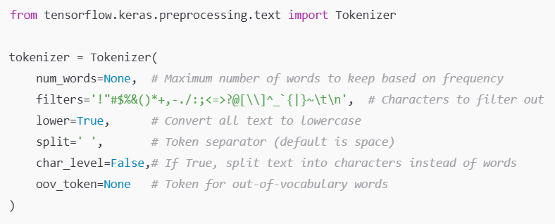
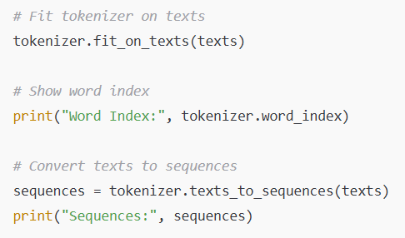

Slide 9
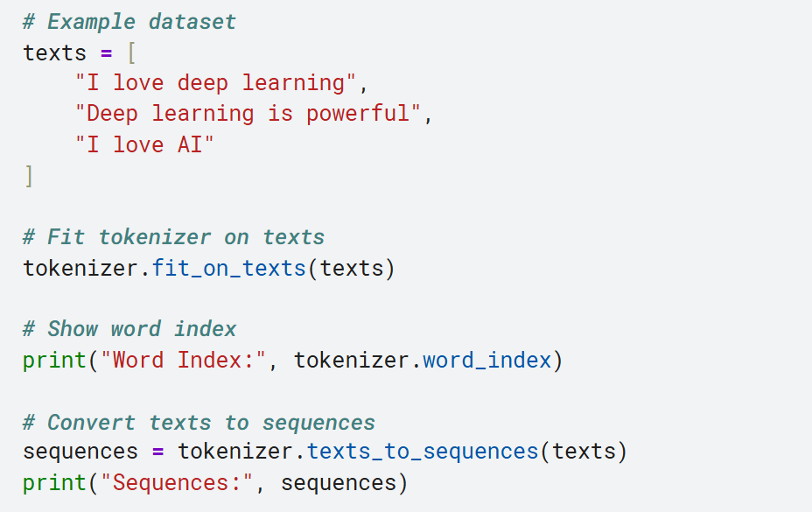

Slide 10
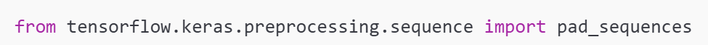
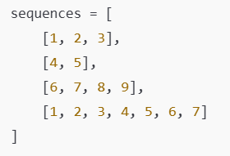
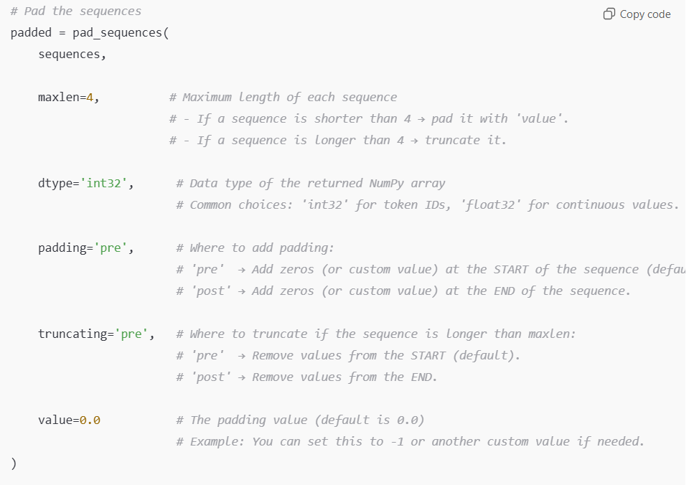
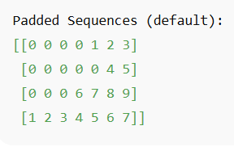
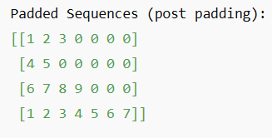
padding Pre
padding Post

Slide 11

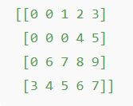

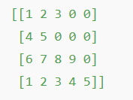

Slide 12
Thanks

